Slide 1
Deep Learning Approaches to Semantic Segmentation of Diagram
Duc Tri Dang
Supervised by Dr. Michael Cormier

Slide 2
Land Acknowledgement
We would like to acknowledge that we are located within the territory of Mi’kma’ki, the unceded, ancestral territory of the Mi’kmaq.
Our relationship and our privilege to live on this territory was agreed upon in the Peace and Friendship Treaties of 1752.
Because of this treaty relationship it is to be acknowledged that we are all Treaty people and have a responsibility to respect this territory.

Slide 3
Table of contents
Project Acknowledgement
TADA: Diagrams Accessible to Blind and Low-Vision People
Related works
CNNs and SegNet Model
Superpixel segmentation
Models and Architecture
Experiments
Discussion and takeaways
Future Works

Slide 4
Project Acknowledgement
I would like to acknowledge Dr. Michael Cormier from Mount Allison University, Yichun Zhao, Dr. Miguel A. Nacenta, and Sowmya Somanath from University of Victoria and Dr. Mahadeo Sukhai from Canadian National Institute for the Blind had allowed me to participate and have my thesis as a part of the TADA project.

Slide 5
TADA: Diagrams Accessible to Blind and Low-Vision People
Support Blind and Low-Vision People to access diagrams and overcome the lack of text descriptions and interactive techniques.
A tablet-based interactive system that makes diagram exploration accessible through musical tones and speech.
TADA’s Design:
Spatiality
Distinguishable Components
Multiple Levels of Access
Complimentary Interactions

Slide 6
TADA Project pipeline
Semantic Segmentation
Instance Segmentation
Results Classifier
Graph Model
TADA Interface
Source: Cameron Swift

Slide 7
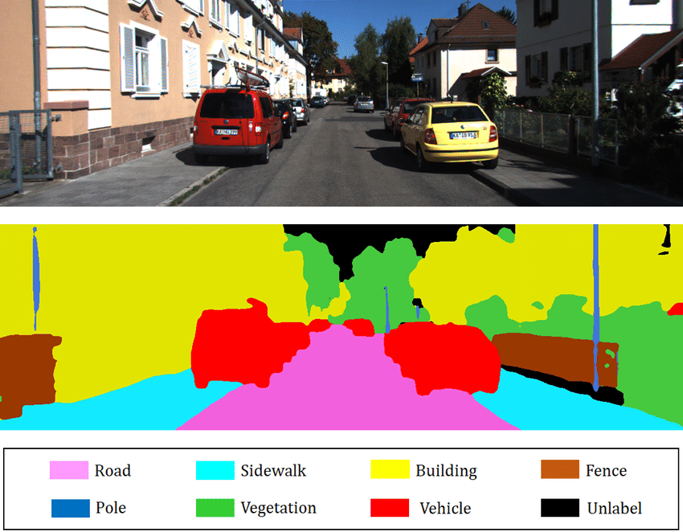
Semantic Segmentation
Semantic segmentation creates the classification of different components in the image.
Source: Towards AI

Slide 8
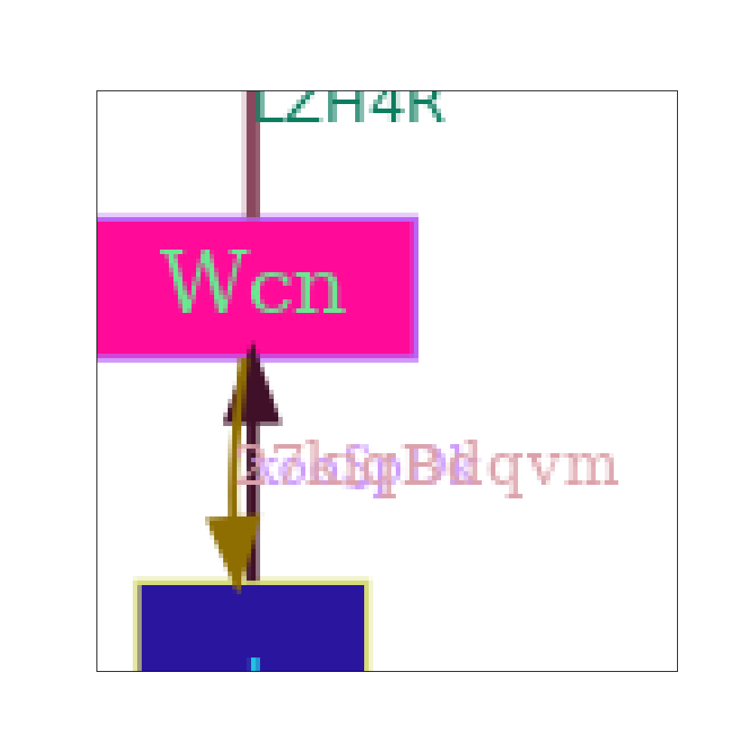
Semantic Segmentation of TADA Project
In this project, we are focusing on 5 main components in a graph, or 5 main classes.
Background
Text
Edge
Node interior
Node border

Slide 9
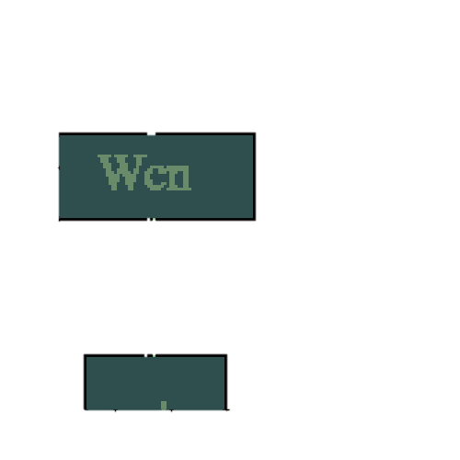
Semantic Segmentation of TADA Project
In this project, we are focusing on 5 main components in a graph, or 5 main classes.
Background
Text
Edge
Node interior
Node border

Slide 10
Semantic Segmentation of TADA Project
In this project, we are focusing on 5 main components in a graph, or 5 main classes.
Background
Text
Edge
Node interior
Node border

Slide 11
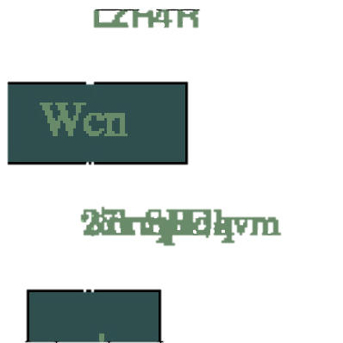
Semantic Segmentation of TADA Project
In this project, we are focusing on 5 main components in a graph, or 5 main classes.
Background
Text
Edge
Node interior
Node border

Slide 12
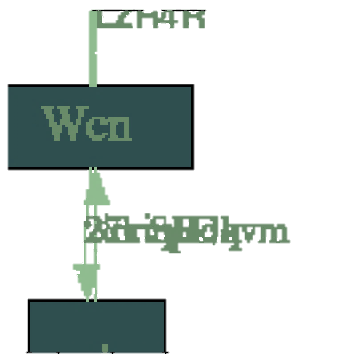
Semantic Segmentation of TADA Project
In this project, we are focusing on 5 main components in a graph, or 5 main classes.
Background
Text
Edge
Node interior
Node border

Slide 13
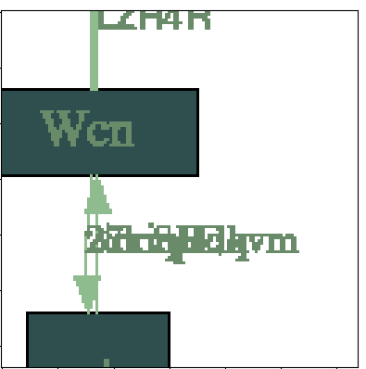
Semantic Segmentation of TADA Project
In this project, we are focusing on 5 main components in a graph, or 5 main classes.
Background
Text
Edge
Node interior
Node border

Slide 14

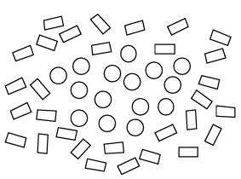


Gestalt Theory
Vicinanza
The proximity rule
Somiglianza
The similarity rule
Color constancy
Source: Desolneux et al., 2008

Slide 15
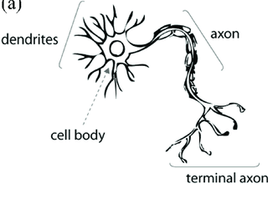

What is Neural Network?
Source: Damién 2021

Slide 16
What is CNNs?
CNNs are trained through their convolutional layers to recognize various patterns in the input images. Convolutional layers are followed by a fully connected neural network, which is used to translate those features obtained from the previous layers to the given output phases (Karimpouli & Tahmasebi, 2019).

Slide 17
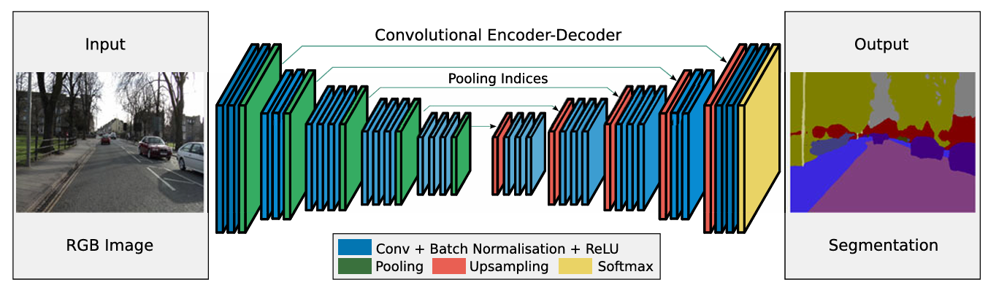
SegNet Model
Source: Badrinarayanan et al., 2017

Slide 18
SegNet Model
Convolutional layer: In this layer, input images or feature maps from the last layer are convolved with some small size filters (or kernels) to generate new feature maps. These convolutions are being performed with a shift of “n” pixels, which are called stride (Krizhevsky et al., 2012).
Source: Badrinarayanan et al., 2017

Slide 19
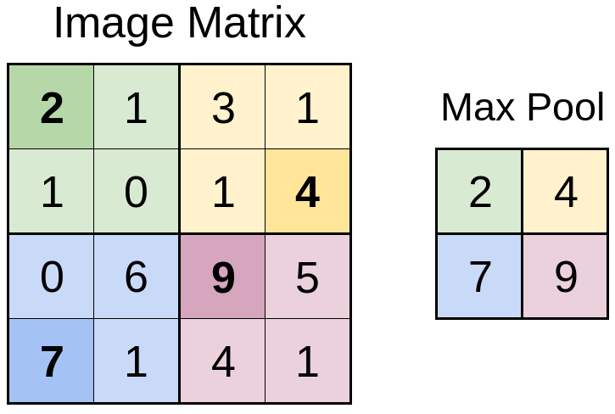
SegNet Model
Max-pooling layer: This layer is a form of down-sampling, where it is used to summarize data by choosing the local maximum in a sliding window moving across the feature maps with a stride of the same length.
Source: Badrinarayanan et al., 2017; Austin, 2019

Slide 20
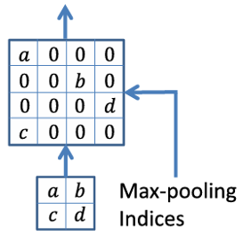
SegNet Model
Up Sampling layer: This layer will receive the indices from the pooling layers, then create a larger matrix with 0 and fill the features with its original indices.
Source: Badrinarayanan et al., 2017

Slide 21
Key terms
Epoch is defined as the number times that the learning algorithm will work through the entire training dataset.
Accuracy refers to the proportion of correct predictions and the total predictions in both training and validation data. The range of the accuracy value can be varied from 0% (all wrong) to 100% (perfectly predicted). In this project, we are aiming for the accuracy of the models to be around 80%.
Loss demonstrates the difference between the ground truth and the predicted values. This loss value is expected to decrease over learning time.

Slide 22
Key terms
Accuracy
Loss
Forwarding pass
Notes:
Weight
Accuracy
Loss
Forward propagation
Backward propagation
Gradient descent

Slide 23
Key terms
Backpropagation
Notes:
Weight
Accuracy
Loss
Forward propagation
Backward propagation
Gradient descent

Slide 24
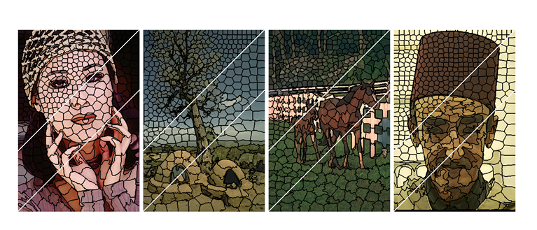
Superpixel
First introduced in 2003, by Xiaofeng Ren and Jitendra Malik. The paper name is “Learning a Classification Model for Segmentation”.
Superpixels are the result of oversegmentation. Superpixels are group of pixels that share common features.
Superpixels need to be local, coherent, and which preserve most of the structure necessary. (Ren et Malik, 2003)
Source: Li et Chen, 2015

Slide 25
Input Data
There are 3 types of data: training, validation and testing data:
Training: There are 2500 images divided into 10000 smaller patches with size 128 × 128 along side with their labels.
Validation and Testing: There are 1000 images divided into 3000 smaller patches of image with size 128 × 128 along side with their labels for each of validation and testing set.

Slide 26
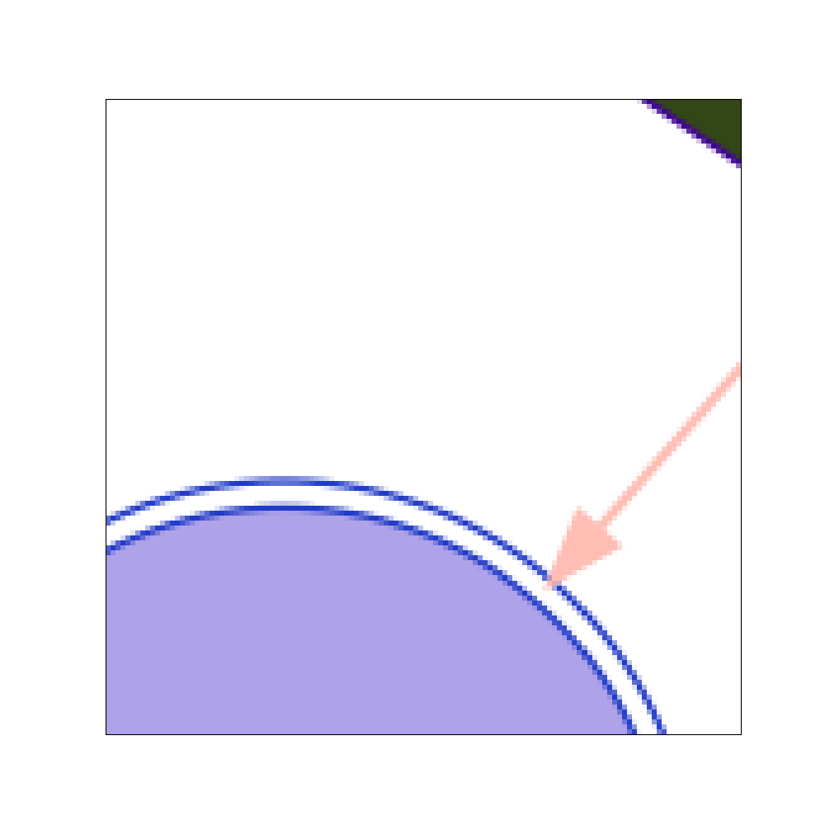
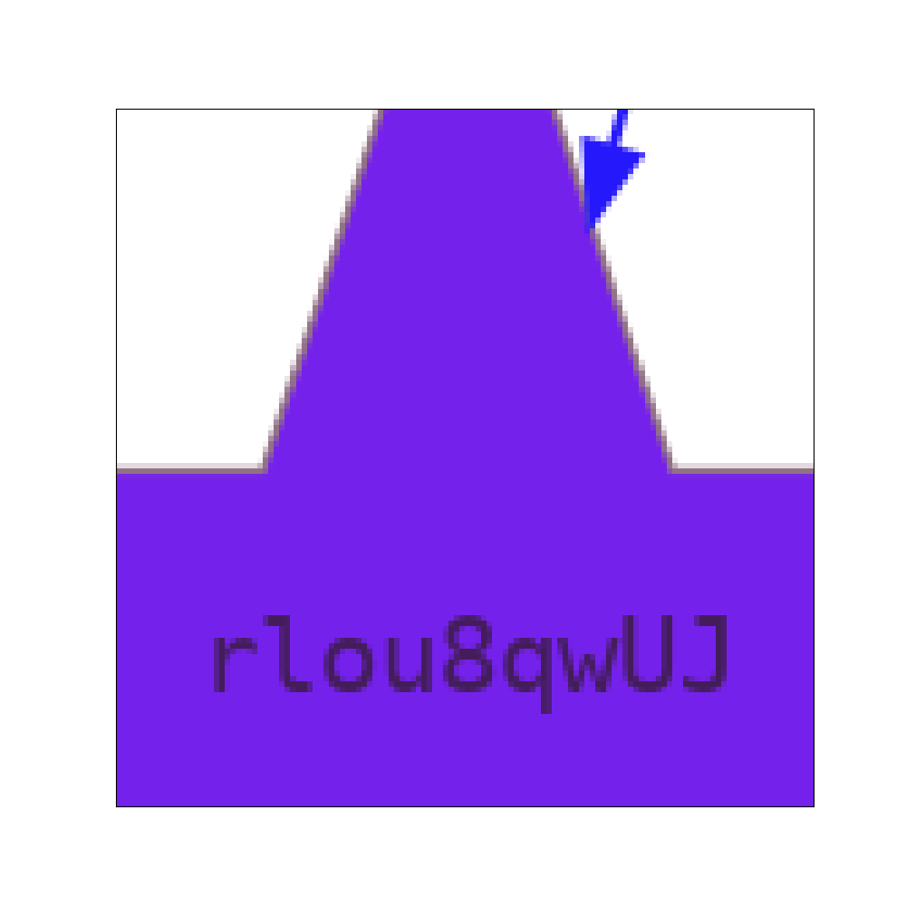
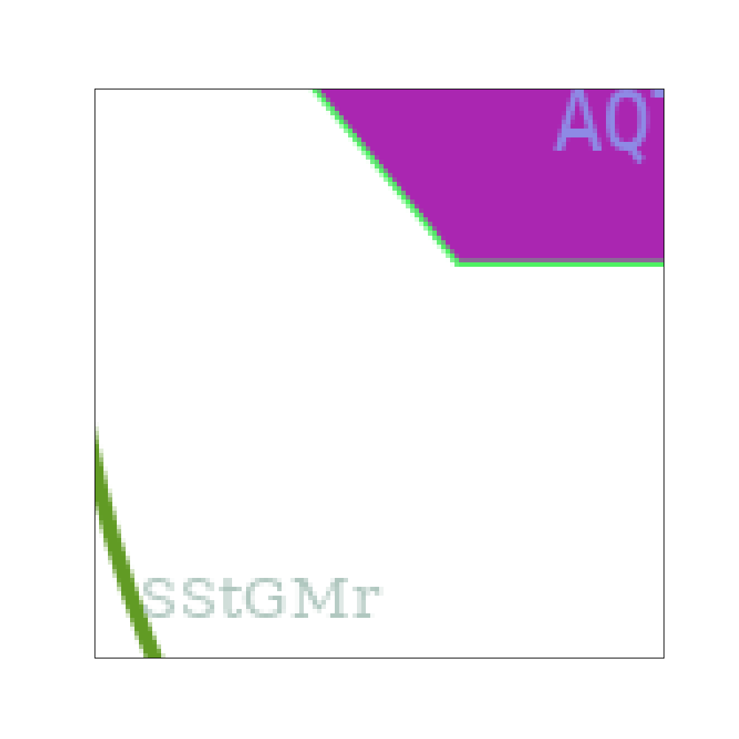
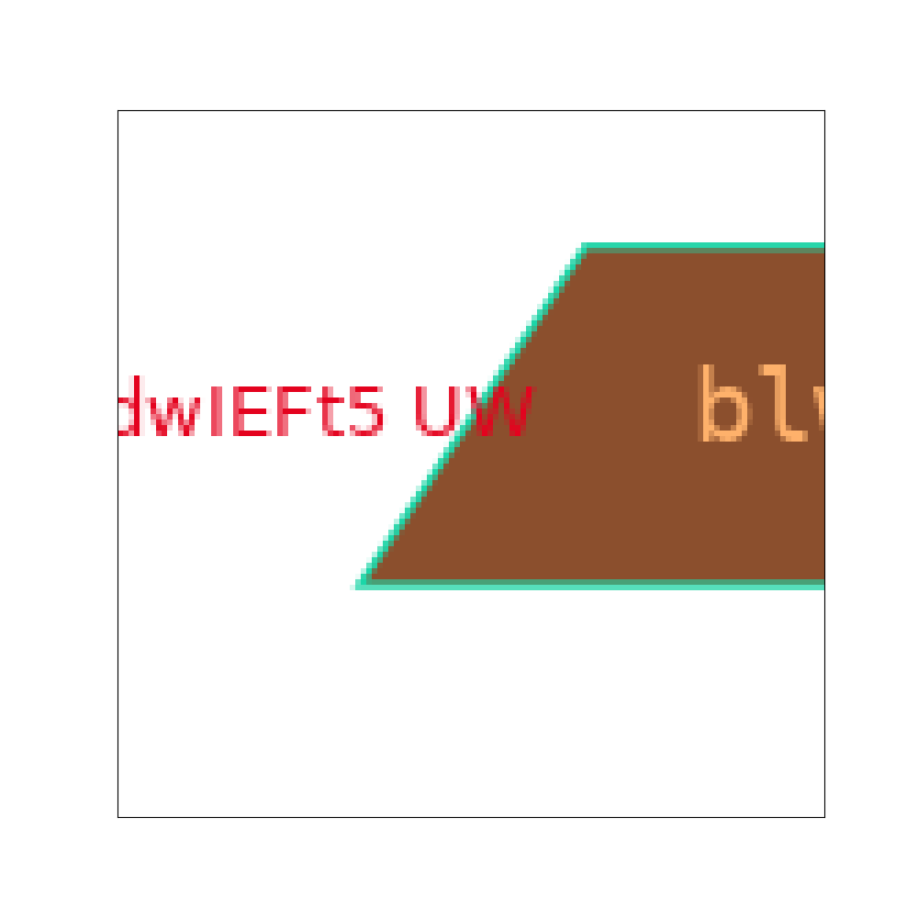
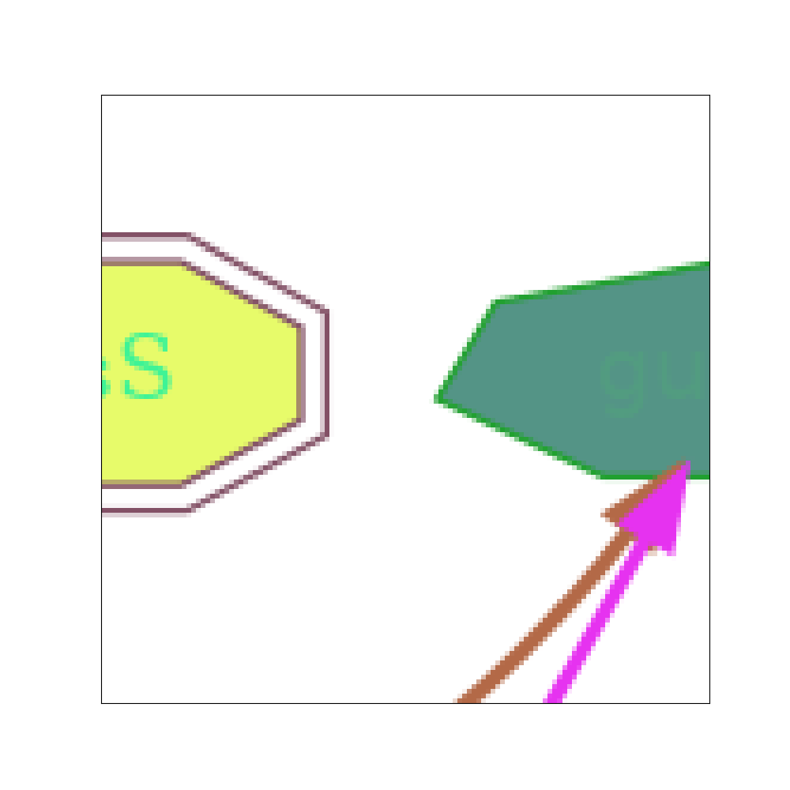
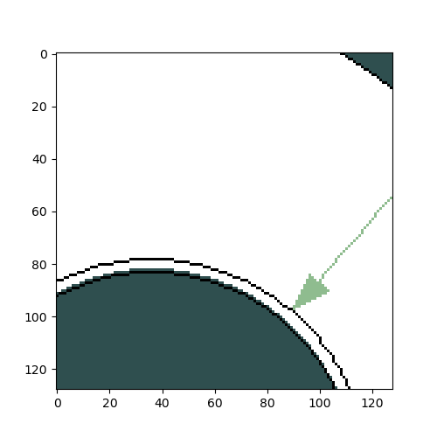
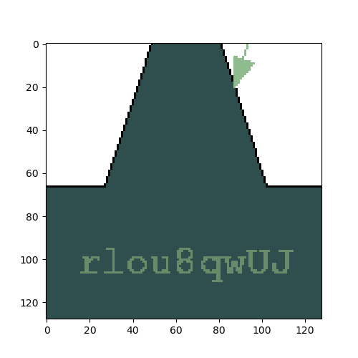
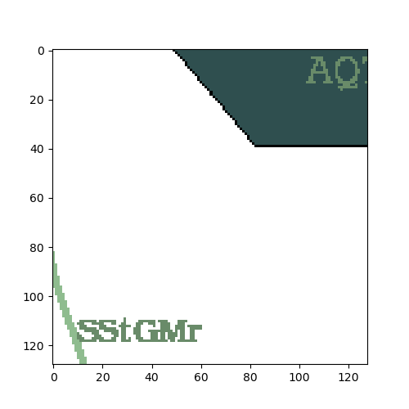
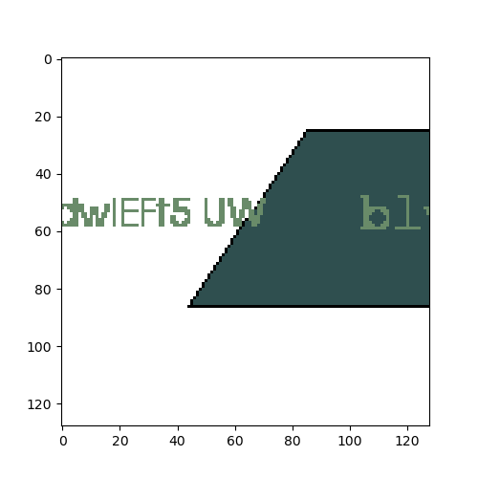
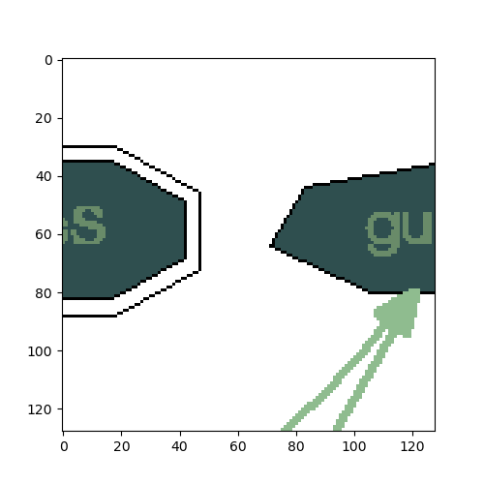
Input Data
Input Patch Image Sample
Input Patch Label Sample

Slide 27
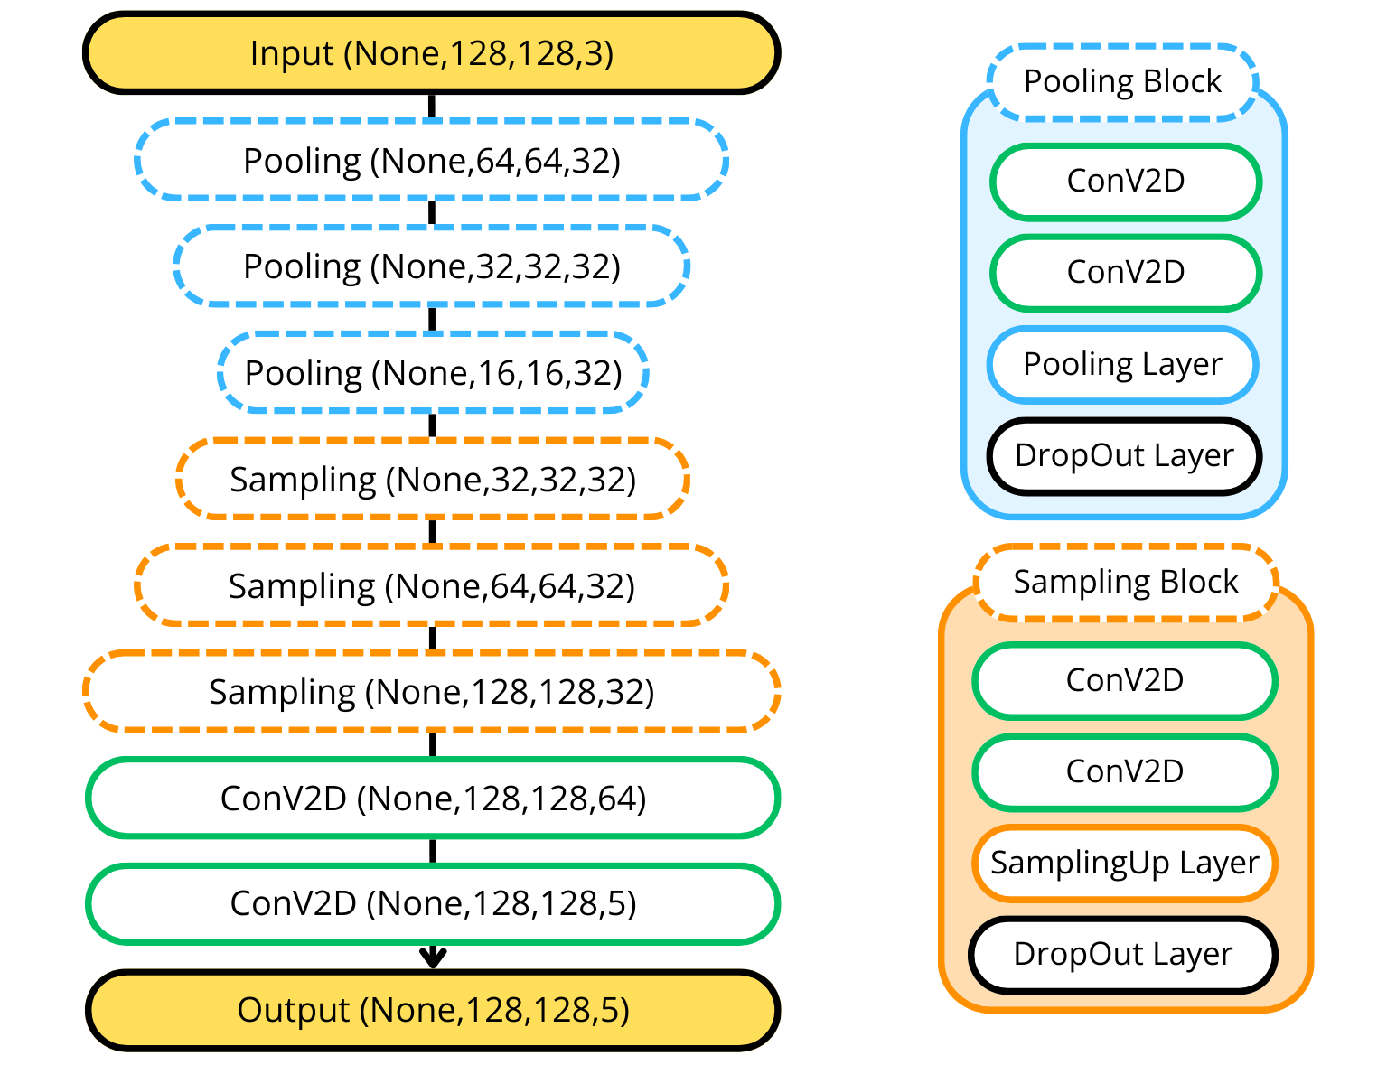
Model V1
Model V1 is inspired from the SegNet model, but with some adjustment:
Add in DropOut Layer to avoid overfitting.
Make the model simpler by using only 12 ConV Layers.
Not passing the indices into UpSampling layers.

Slide 28
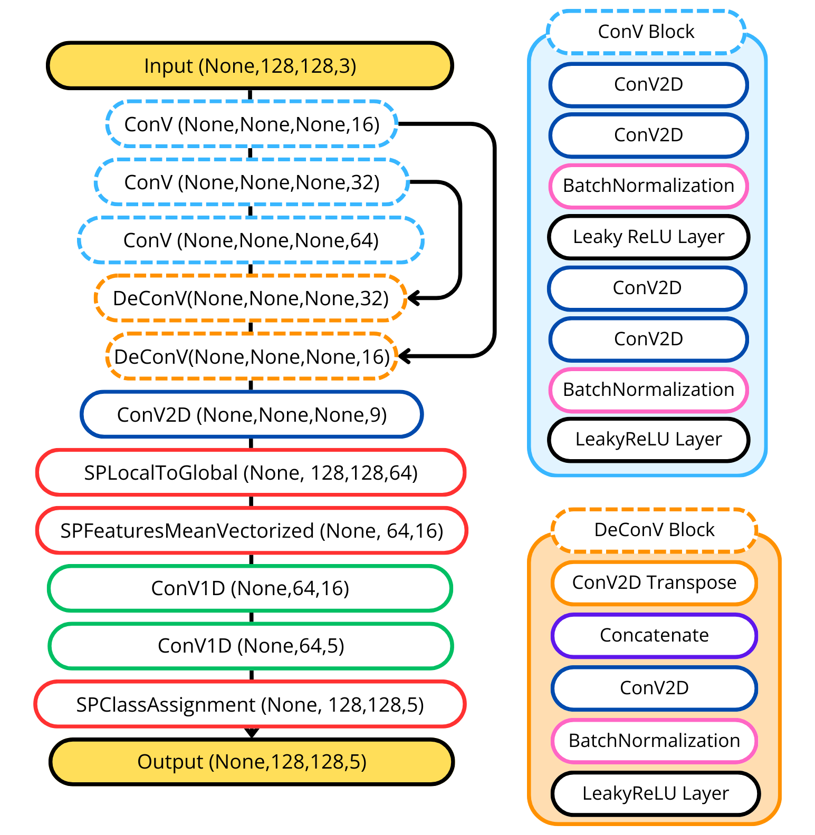
Model V2
First, the model will learn the features and create the superpixel map.
After that, calculate the mean of all features learned for all superpixels.
Next, perform classification on superpixels.
Finally, maps the class of the superpixel to all pixels.

Slide 29
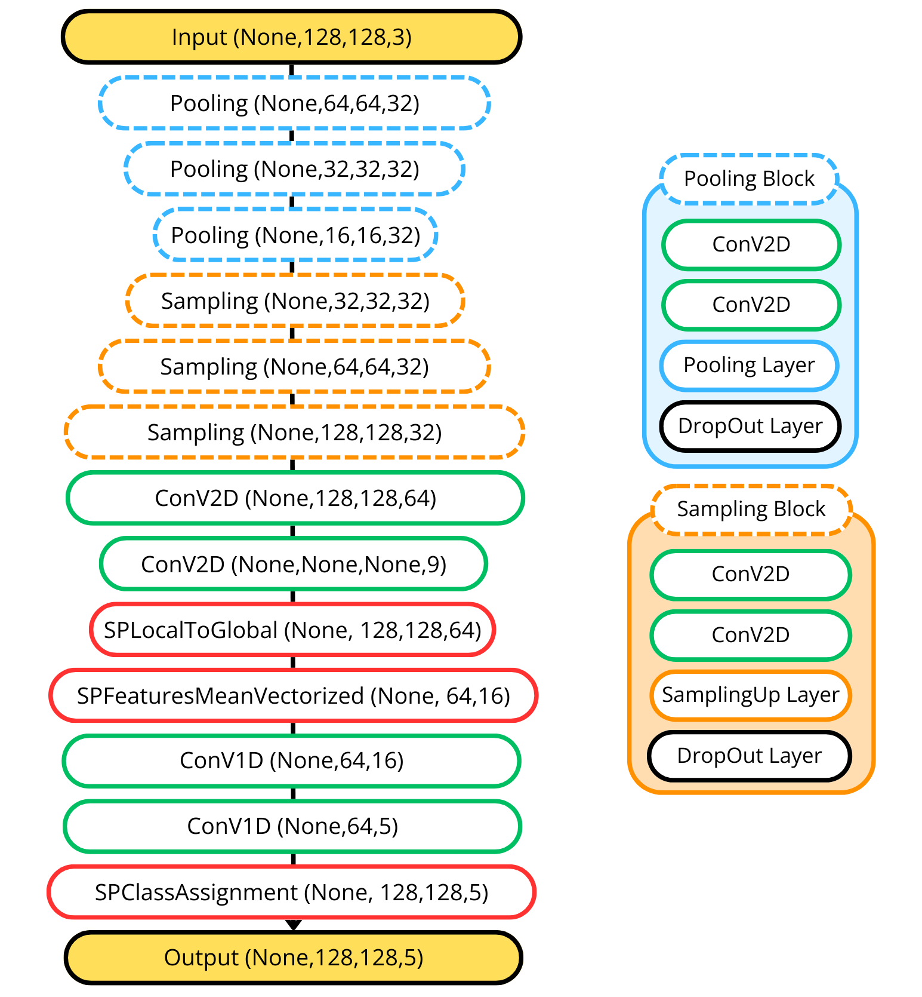
Model V3
Combination of model V1 and model V2 to improve performance.
Decrease the size of superpixels and increase the number of superpixels.

Slide 30
Experiment Results
The evaluation of a model will be based on the criteria of accuracy, loss, and the quality of the prediction image over several epochs.

Slide 31



Experiment Results
Ground Truth
V1 Model
Sample Input
V2 Model
V3 Model

Slide 32

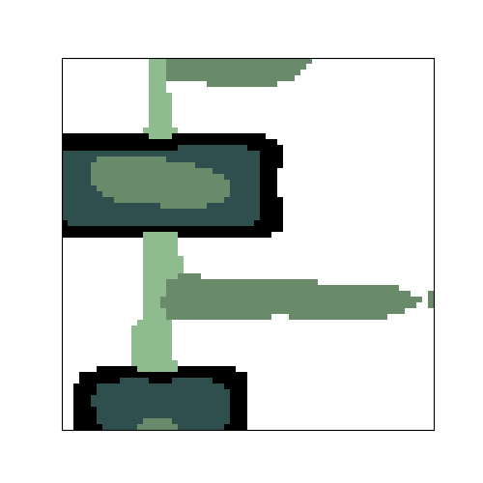
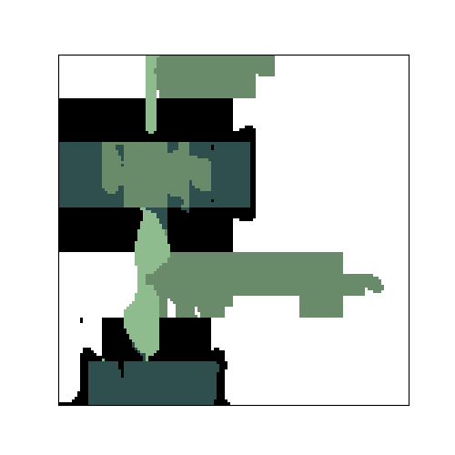
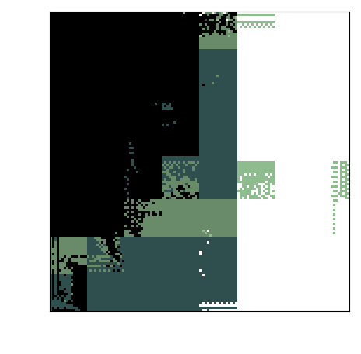
Experiment Results
Ground Truth
V1 Model
Sample Input
V2 Model
V3 Model

Slide 33
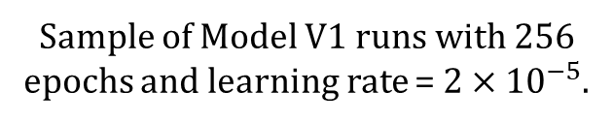
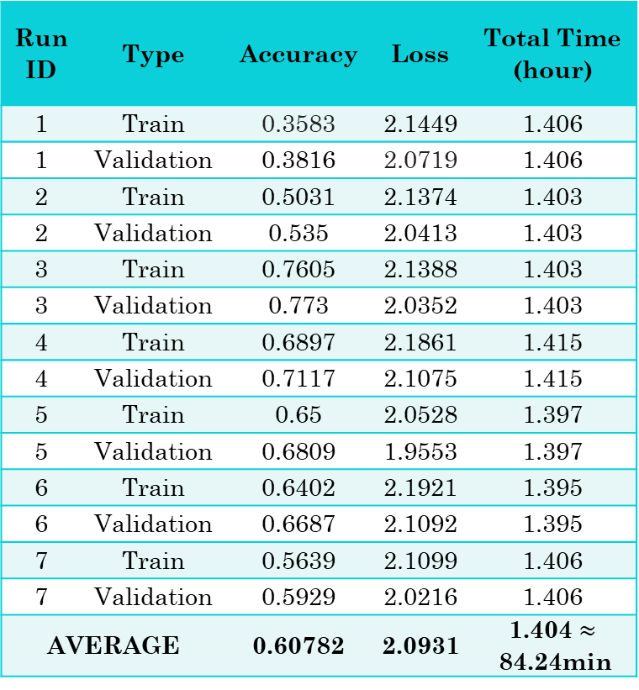
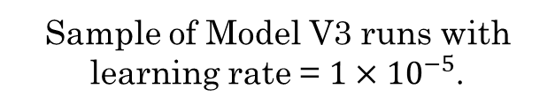
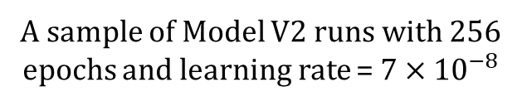
Experiment Results
Run ID | Type | Accuracy | Loss | Total Time (hour)
1 | Train | 0.3583 | 2.1449 | 1.406
1 | Validation | 0.3816 | 2.0719 | 1.406
2 | Train | 0.5031 | 2.1374 | 1.403
2 | Validation | 0.535 | 2.0413 | 1.403
3 | Train | 0.7605 | 2.1388 | 1.403
3 | Validation | 0.773 | 2.0352 | 1.403
4 | Train | 0.6897 | 2.1861 | 1.415
4 | Validation | 0.7117 | 2.1075 | 1.415
5 | Train | 0.65 | 2.0528 | 1.397
5 | Validation | 0.6809 | 1.9553 | 1.397
6 | Train | 0.6402 | 2.1921 | 1.395
6 | Validation | 0.6687 | 2.1092 | 1.395
7 | Train | 0.5639 | 2.1099 | 1.406
7 | Validation | 0.5929 | 2.0216 | 1.406
AVERAGE |  | 0.60782 | 2.0931 | 1.404 $≈$84.24min
Run ID | Type | Epoch | Accuracy | Loss | Total Time (hour)
1 | Train | 256 | 0.8222 | 0.3437 | 2.814
1 | Validation | 256 | 0.8329 | 0.3229 | 2.814
2 | Train | 256 | 0.8198 | 0.3511 | 2.817
2 | Validation | 256 | 0.8367 | 0.3252 | 2.817
3 | Train | 256 | 0.8224 | 0.3439 | 2.812
3 | Validation | 256 | 0.8368 | 0.3213 | 2.812
4 | Train | 140 | 0.8077 | 0.4064 | 1.53
4 | Validation | 140 | 0.8221 | 0.3875 | 1.53
5 | Train | 176 | 0.8133 | 0.387 | 2.044
5 | Validation | 176 | 0.8328 | 0.3652 | 2.044
6 | Train | 128 | 0.7982 | 0.4213 | 1.398
6 | Validation | 128 | 0.8176 | 0.3918 | 1.398
7 | Train | 128 | 0.8114 | 0.4005 | 1.4
7 | Validation | 128 | 0.8274 | 0.3731 | 1.4
AVERAGE |  |  | 0.82152 | 0.3672
Run ID | Type | Accuracy | Loss | Total Time (min)
1 | Train | 0.888 | 0.2057 | 45.45
1 | Validation | 0.8838 | 0.1936 | 45.45
2 | Train | 0.8886 | 0.2025 | 46.25
2 | Validation | 0.8713 | 0.1893 | 46.25
3 | Train | 0.8869 | 0.2076 | 45.99
3 | Validation | 0.8647 | 0.1926 | 45.99
4 | Train | 0.8895 | 0.2014 | 45.87
4 | Validation | 0.8756 | 0.1934 | 45.87
5 | Train | 0.8904 | 0.2028 | 45.11
5 | Validation | 0.8677 | 0.1929 | 45.11
6 | Train | 0.8881 | 0.2029 | 45.05
6 | Validation | 0.8733 | 0.189 | 45.05
7 | Train | 0.8892 | 0.2034 | 45.22
7 | Validation | 0.8769 | 0.1855 | 45.22
AVERAGE |  | 0.881 | 0.1973 | 45.563
Sample of Model V1 runs with 256 epochs and learning rate = $2×{10}^{−5}$.
A sample of Model V2 runs with 256 epochs and learning rate = $7×{10}^{−8}$
Sample of Model V3 runs with learning rate = $1×{10}^{−5}$.

Slide 34
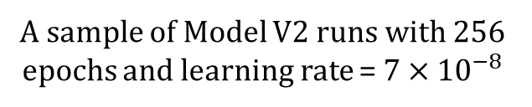

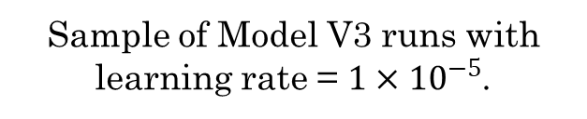
Experiment Results
Run ID | Type | Accuracy | Loss | Total Time (hour)
1 | Train | 0.3583 | 2.1449 | 1.406
1 | Validation | 0.3816 | 2.0719 | 1.406
2 | Train | 0.5031 | 2.1374 | 1.403
2 | Validation | 0.535 | 2.0413 | 1.403
3 | Train | 0.7605 | 2.1388 | 1.403
3 | Validation | 0.773 | 2.0352 | 1.403
4 | Train | 0.6897 | 2.1861 | 1.415
4 | Validation | 0.7117 | 2.1075 | 1.415
5 | Train | 0.65 | 2.0528 | 1.397
5 | Validation | 0.6809 | 1.9553 | 1.397
6 | Train | 0.6402 | 2.1921 | 1.395
6 | Validation | 0.6687 | 2.1092 | 1.395
7 | Train | 0.5639 | 2.1099 | 1.406
7 | Validation | 0.5929 | 2.0216 | 1.406
AVERAGE |  | 0.60782 | 2.0931 | 1.404 $≈$84.24min
Run ID | Type | Epoch | Accuracy | Loss | Total Time (hour)
1 | Train | 256 | 0.8222 | 0.3437 | 2.814
1 | Validation | 256 | 0.8329 | 0.3229 | 2.814
2 | Train | 256 | 0.8198 | 0.3511 | 2.817
2 | Validation | 256 | 0.8367 | 0.3252 | 2.817
3 | Train | 256 | 0.8224 | 0.3439 | 2.812
3 | Validation | 256 | 0.8368 | 0.3213 | 2.812
4 | Train | 140 | 0.8077 | 0.4064 | 1.53
4 | Validation | 140 | 0.8221 | 0.3875 | 1.53
5 | Train | 176 | 0.8133 | 0.387 | 2.044
5 | Validation | 176 | 0.8328 | 0.3652 | 2.044
6 | Train | 128 | 0.7982 | 0.4213 | 1.398
6 | Validation | 128 | 0.8176 | 0.3918 | 1.398
7 | Train | 128 | 0.8114 | 0.4005 | 1.4
7 | Validation | 128 | 0.8274 | 0.3731 | 1.4
AVERAGE |  |  | 0.82152 | 0.3672
A sample of Model V2 runs with 256 epochs and learning rate = $7×{10}^{−8}$
Sample of Model V3 runs with learning rate = $1×{10}^{−5}$.

Slide 35
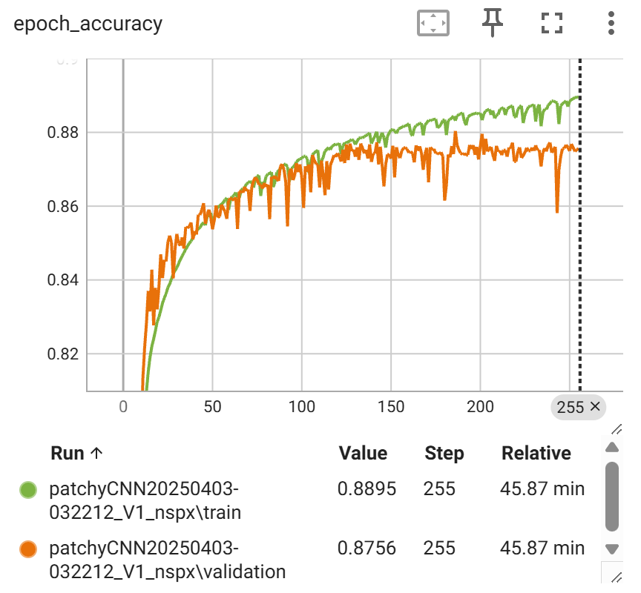
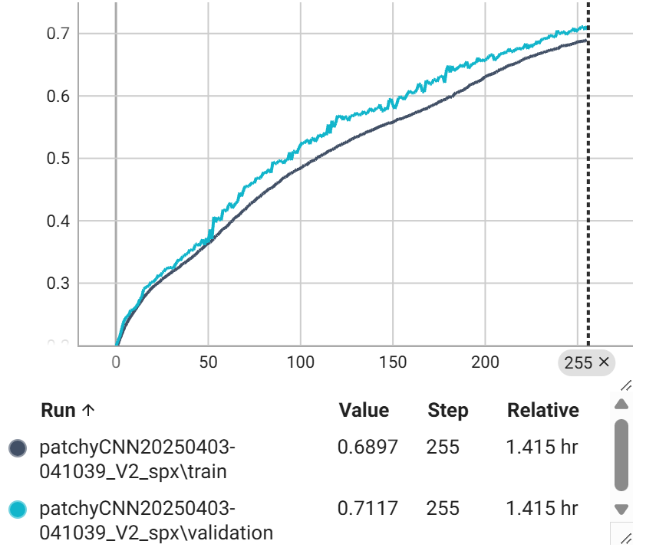
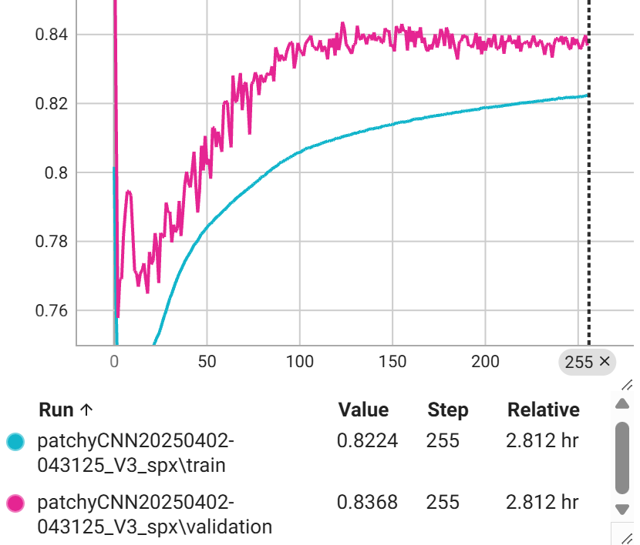
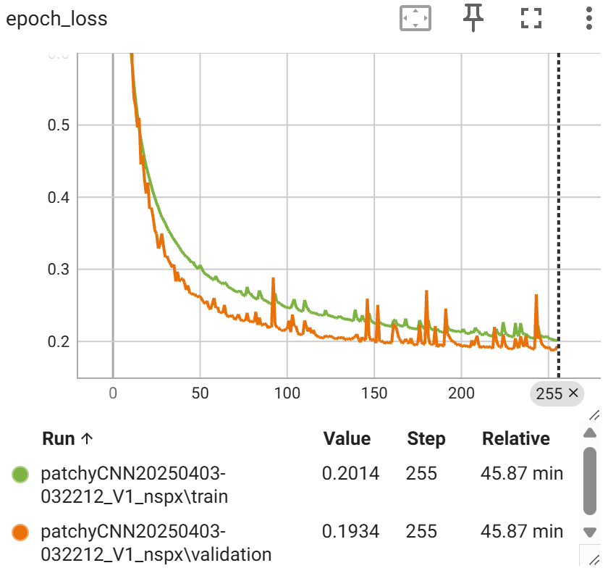
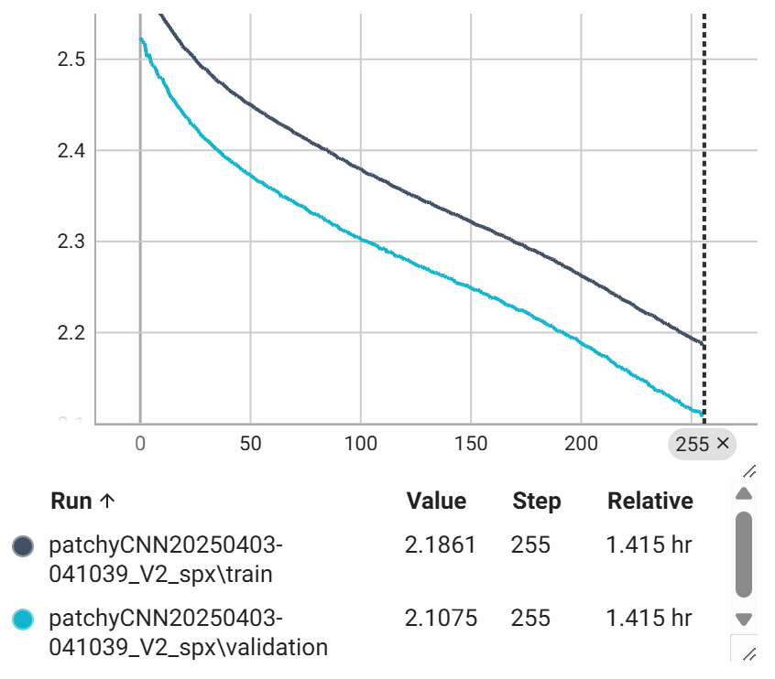
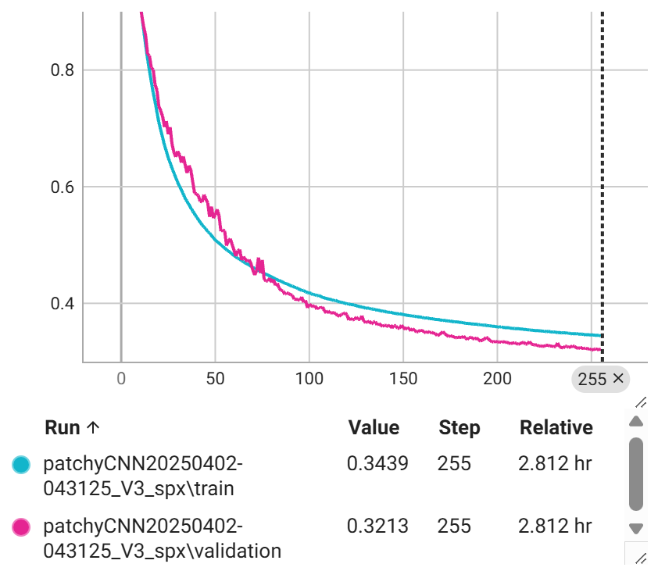
Accuracy over epoch V1
Accuracy over epoch V2
Accuracy over epoch V3
Loss over epoch V1
Loss over epoch V2
Loss over epoch V3

Slide 36
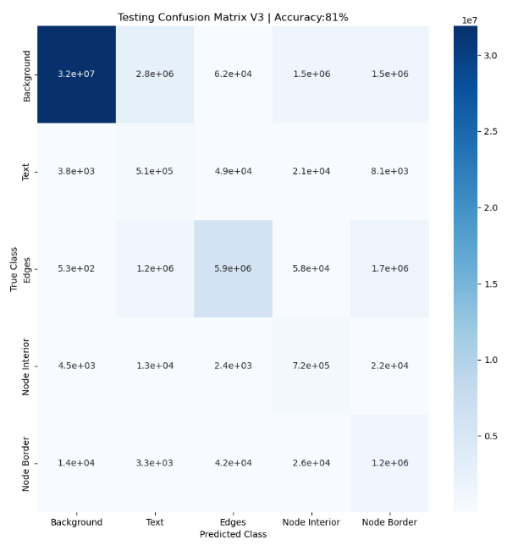

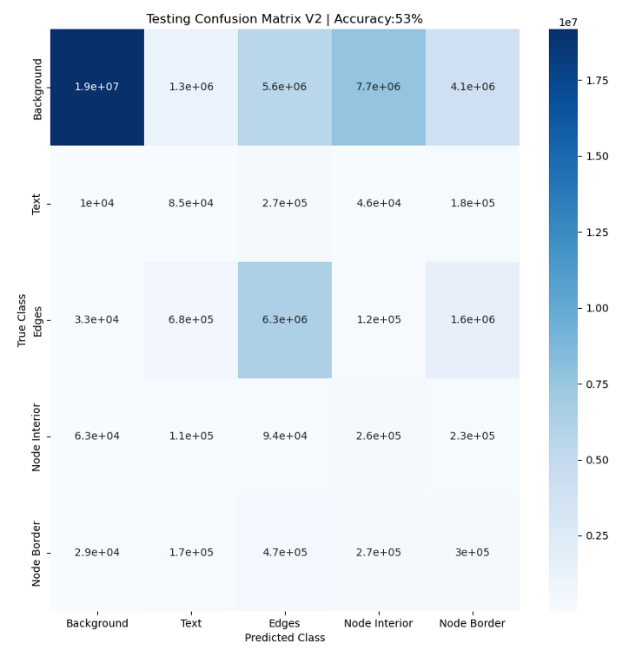

Slide 39
Takeaways
The models predict a wider area for the class. In other words, for the background pixels which stay closely to another class, instead of correctly predicting the background class, the models predict it as the other class.
The fact that Model V1 outweighs both Model V2 and Model V3 in terms of accuracy, loss, and run-time showed that Superpixel segmentation might not be a suitable approach to this project.

Slide 40
Takeaways
Originally, the idea of using superpixel is based on the considerations of using another segmentation algorithm, such as the Normalized Cut.
Use a suitable superpixel generation might lead to a better result.
May be from the beginning, the idea of superpixels is not fit with this project. Superpixels are used to recognize the similarity of nearby pixels of a very massive input image. In the TADA project, there are some factors that might not be fit with superpixels, such as a very thin edge, the border of the nodes, where superpixels can not interpret and learn fully its pattern.
Notes:
Implementing a Normalized Cut graph-based algorithm will be very complicated for each pixel, but it will be possible to dealing with superpixels.

Slide 41
Future Works
Optimize the model
Created new variations of the models
Test the models with larger and more complicated data input and higher number of learning epochs
Integrating the model into the TADA pipeline and test it with real data

Slide 42
Thank you for listening!
Any questions?

